Slide 1
Creating Inclusive Schools for LGBTQ Students Worldwide
Educare alle Differenze – Il Meeting Nazionale 8 Edizione, Pescara, Italia
Joseph Kosciw, PhD
Director
GLSEN Research Institute

Slide 2

Acknowledgements
Thank you to the U.S. State Department and the U.S. Embassy in Rome for their support in bringing me to Italy and for this meeting – especially Raissa Brighi from the Public Affairs Office at the Embassy.
Special thanks to Valeria Roberti from Centro Risorse LGBTI for asking me to speak here today.

Slide 3

is the leading national education organization focused on ensuring safe schools for all students. Established in 1990, GLSEN envisions a world in which every child learns to respect and accept all people, regardless of sexual orientation or gender identity/expression. GLSEN seeks to develop school climates where difference is valued for the positive contribution it makes to creating a more vibrant and diverse community.
Leading Research
Educational Resources & Training
Student Leadership
Policy Advocacy
Public Awareness
40 State & Local Chapters
Notes:
Research: We conduct extensive and original research to inform our evidence-based solutions for K-12 education.
Educational Resources & Training: We author developmentally appropriate resources for educators to use throughout their school community and providing professional development trainings on LGBTQ+ issues at school.
Student Leadership: We empower students to affect change by supporting student-led efforts to positively impact their own schools and local communities, and have thousands of registered GSAs nationwide.
Policy Advocacy: We advise on, advocate for, and research comprehensive policies designed to protect LGBTQ students as well as students of marginalized identities.
Public Awareness: Promote awareness of LGBTQ+ student experiences in media.
State & Local Chapters: We coordinate a network of over 40 chapters in 30 states across the nation, to ensure that we have access to schools and districts across the country to reach every student.

Slide 4

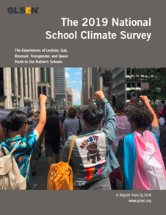
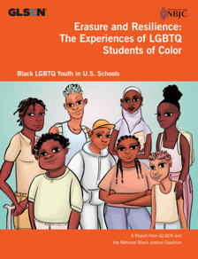
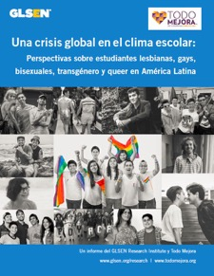
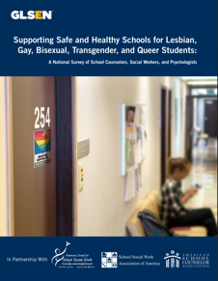
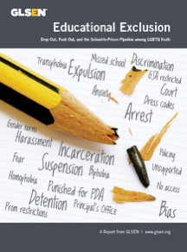
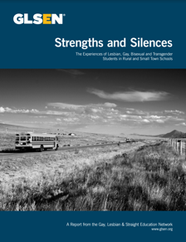
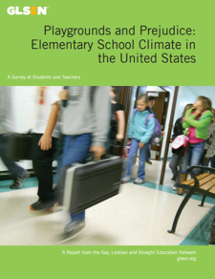
supports the organization's mission by conducting original research on issues of sexual orientation and gender identity/expression in elementary and secondary education and evaluating GLSEN programs and initiatives.

Slide 5
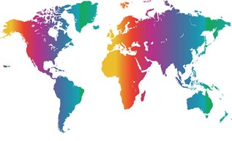

Supporting NGOs Worldwide
Best Practices
Knowledge
NGOs Globally
© GLSEN 2018
Notes:
We also assist educators and NGO leaders globally on documenting the experiences of LGBTQ+ youth in schools.
To date, there have been national surveys of LGBTQ+ secondary students in 20 European countries, including Italy – thanks to Valeria Roberti and Centro Risorse LGBTI.

Slide 6

Free from…
Per una scuola libera…
…da violenze di genere
…dall'omofobia e transfobia
…da stereotipi di genere
…dalla disinformazione

Slide 7

Free to Be…
Famous children’s book in the U.S. “Free to Be…You and Me” (“Libero di Essere Te e Me”)
Written by a famous U.S. actress Marlo Thomas.
Published in 1972 and reflects post-1960s values regarding gender neutrality, individuality, tolerance, and comfort with one's identity.
Notes:
I was immediately reminded of a very famous children’s book in the U.S. “Free to Be…You and Me” (“Libero di Essere Te e Me”) and written by a famous U.S. actress Marlo Thomas. It was published in 1972 and reflects post-1960s values regarding gender neutrality, individuality, tolerance, and comfort with one's identity. A major thematic message in the book is that anyone can achieve anything – regardless of gender. So in 1972, I was in elementary school and as a young child, found it very comforting to read messages about individuality, acceptance, and embracing difference. And it made me wonder if, in fact, that is some small way contributed to my career path – first as a school counselor, then a family therapist, and now as a researcher doing research that supports the idea that when students are in schools that are “free from…” violence, discrimination, and intolerance, that is “una scuola libera PER tutti” and are free to be themselves and free to succeed. Also, the founder of Kevin Jennings was also in elementary school at that time, and perhaps this idea of being “free to be you and me” also, in some part, contributed to his founding an organization devoted to creating schools where everyone is accepted and can thrive.

Slide 8
School Climate for LGBTQ Students

Slide 9
Hostile Experiences in School
Notes:
Caitie and Adrian

Slide 10
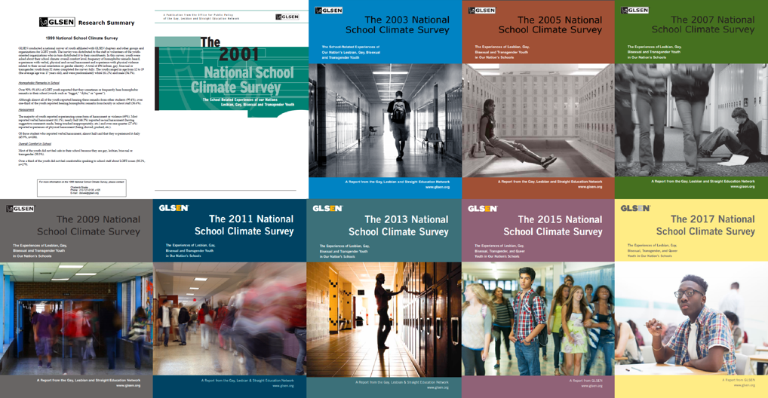

School Climate for LGBTQ Students
First conducted in 1999 given no national research on LGBTQ students
Conducted every 2 years
The only continuing national research focused on LGBTQ youth in schools
Notes:
As I mentioned, GLSEN was founded in 1990 by teachers who were seeing what a difficult time LGBTQ students were having, and wanted to make a difference. However, in the early years of GLSEN, it was often challenging to advocate with education leaders because there was no national evidence on the name-calling, bullying, and harassment LGBTQ+ students were experiencing in schools. People would respond “Oh, that is not common” or “Oh, that doesn’t happen in our school – go to another school.” So then it was important for GLSEN to begin collecting data on school climate for LGBTQ+ students, and since 1999 we have been doing a biennial national survey of LGBTQ+ secondary school students – the National School Climate. (And for these reasons, we felt it was important to lend our research skills to NGOs in other countries who need the same information on their students.)

Slide 11
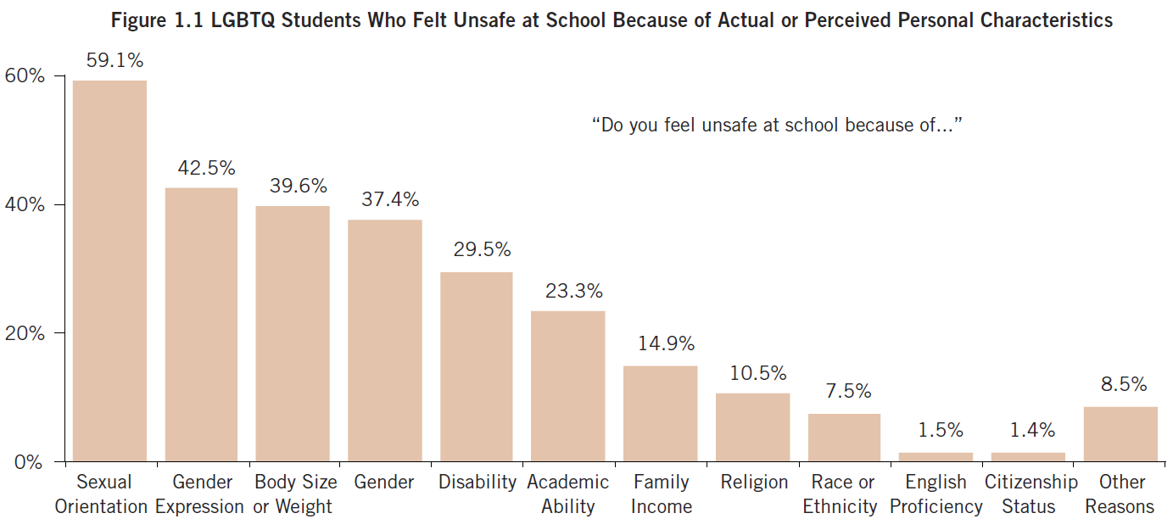
Safety at School
4 in 5 LGBTQ students (79.6%) felt unsafe because of a personal characteristic

Slide 12
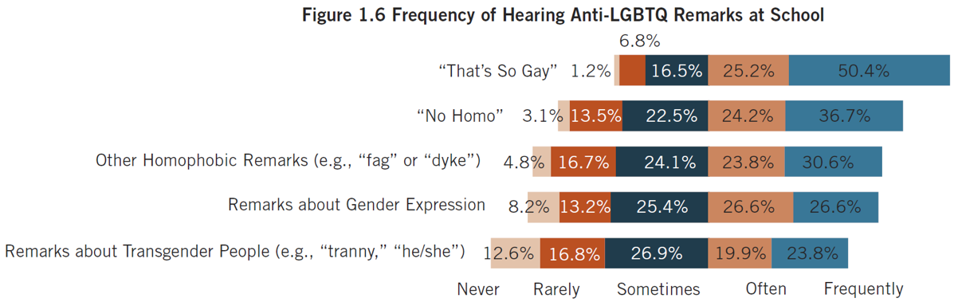
Biased Language
The majority of LGBTQ students regularly (often/frequently) heard
homophobic remarks & negative remarks about gender expression

Slide 13
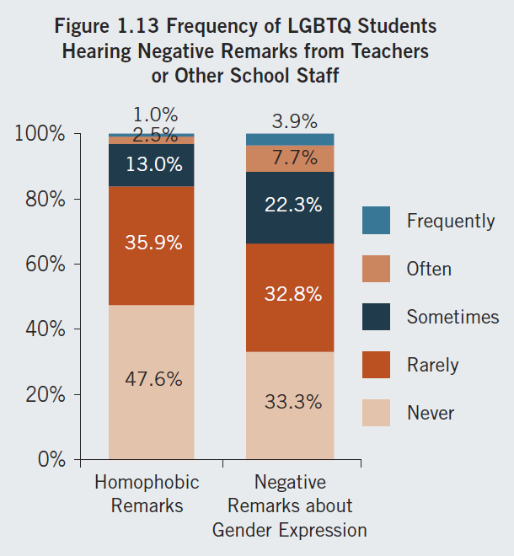
Biased Language
The majority of LGBTQ students heard anti-LGBTQ language from school staff

Slide 14
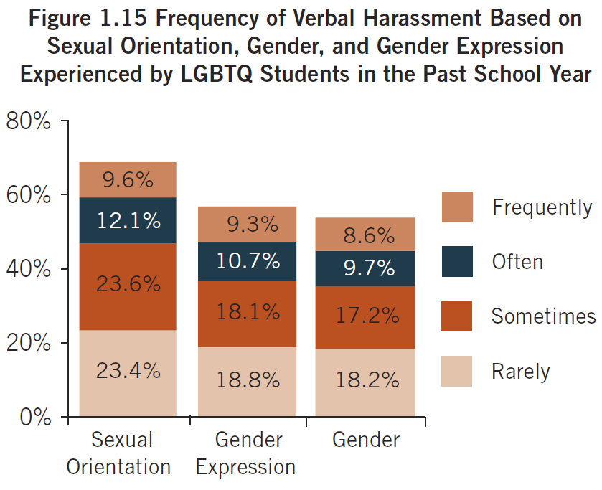
Harassment & Assault
Over 4 in 5 LGBTQ students (86.3%) experienced identity-based harassment & assault
Sexual orientation & gender expression were the most commonly targeted characteristics
Notes:
Caitie

Slide 15
Harassment & Assault
Over 4 in 5 LGBTQ students (86.3%) experienced identity-based harassment & assault
Sexual orientation & gender expression were the most commonly targeted characteristics
68.7%
56.9%
53.7%

Slide 16
Global Crisis

Slide 17





















European Partners
Finland
Russia
Iceland
Estonia
Ireland
Latvia
Poland
Lithuania
Belgium
Ukraine
The Netherlands
Romania
Italy
Slovakia
Portugal
Bulgaria
In partnership with (in blue):
Malta
Slovenia
Hungary
Greece
Notes:
Three Approaches to Conducting
Research in the Region
Creating a regional network and strategy to implementing research
Partnering with university researchers
Working with outside funding sources to create partnerships

Slide 18
Europe: Feeling Unsafe at School
Iceland
Poland
Lithuania
sexual orientation: 33.1%
gender expression: 24.9%
sexual orientation: 52.1%
gender expression: 32.8%
sexual orientation: 64.1%
gender expression: 43.4%
Belgium
Romania
sexual orientation: 41.1%
gender expression: 26.9%
sexual orientation: 48.1%
gender expression: 40.0%
Greece
Malta
40% avoid school for safety reasons
Italy
sexual orientation: 49.6%
gender expression: 28.5%
sexual orientation: 46.6%
gender expression: 31.4%
Notes:
In most countries (except Iceland), around half or more feel unsafe at school because of their sexual orientation.
Ranges from 1/3 in Iceland to 2/3 in Lithuania
Between 1/4 and 1/3 also feel unsafe because of gender expression

Slide 19
Europe: Homophobic Remarks at School
Iceland
Poland
Lithuania
94.5% ever
75.7 sometimes, often or frequently
95.5% ever
80.8% sometimes, often or frequently
94.9% ever
81.3% sometimes, often or frequently
Belgium
Romania
96.7% ever
83.5% sometimes, often or frequently
93.6% ever
81.6% sometimes, often or frequently
Greece
Malta
96.9% ever
86.7% sometimes, often or frequently
Italy
96.4% ever
83.2% sometimes, often or frequently
97.5% ever
85.4% sometimes, often or frequently
Notes:
Homophobic Remarks
9/10 of students across the 7 countries hear these remarks in school
For example, in Italy, 97.5% of LGBTQ+ students hear homophobic remarks at school

Slide 20
Europe: Verbal Harassment (high levels - often or frequently)
Iceland
Poland
Lithuania
14.7% sexual orientation
10.9% gender expression
65.5% sexual orientation
62.8% gender expression
46.3% sexual orientation
51.2% gender expression
Belgium
Romania
30.7% sexual orientation
25.0% gender expression
55.7% sexual orientation
55.4% gender expression
Greece
Malta
31.1% sexual orientation
50.3% gender expression
34.8% sexual orientation
34.8% gender expression
Italy
33.7% sexual orientation
41.3% gender expression
Notes:
Strikingly, the frequency within most countries was similar for harassment re: sexual orientation and re: gender expression.
In Italy nearly two-thirds (62.5%) ever experienced verbal harassment because of their sexual orientation and a higher percentage (66.8%) experienced it because of their gender expression, although there were other countries in Europe where the rates of anti-LGBTQ+ harassment and assault were higher.
It is interesting to note that we started to see a pattern where in Northern Europe and Eastern Europe, the rates of victimization regarding sexual orientation were similar to victimization regarding gender expression, but in Southern Europe, we often saw that victimization regarding gender expression was somewhat higher than victimization regarding sexual orientation. Although it may be related to levels of outness among LGBTQ+ students, it may also be that there are cultural factors where policing of gender – how masculine a boy should be or how feminine a girl should be – is more common in certain countries or certain regions than others.

Slide 21
Europe: Cyberbullying
Lithuania
Iceland
28.3%
Poland
21.0%
22.5%
Belgium
31.7%
Romania
36.6%
Malta
Italy
45.0%
35.3%

Slide 22
Effects of a Hostile Climate

Slide 23
Victimization & discrimination were both associated with poorer academic outcomes.
Victimization
&
Discrimination
Lower GPA
Lower School Belonging
Lower Educational Aspirations
More Missed School
Notes:
What is also a global phenomenon is what results from these negative school experiences for LGBTQ+ students:
Missing School
Less attachment to school and learning
Poorer academic performance
Not pursuing further education
Poorer mental health

Slide 24
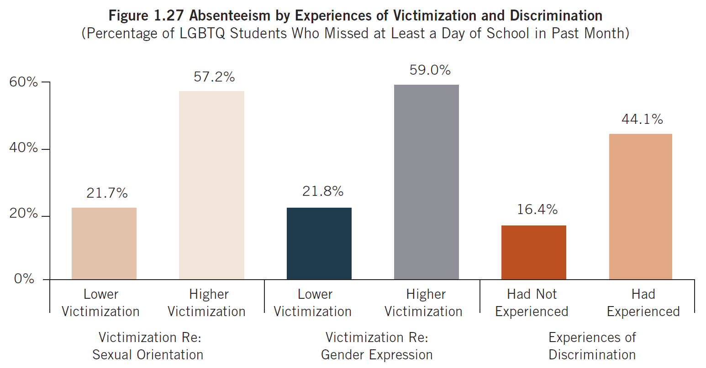
Effects of a Hostile School Climate
In both U.S. and Italy, those who experienced victimization were approxiatey twice as likely to skip school because they felt unsafe
Source: Be Proud! Speak Out! Ricerca nazionale sull’esperienza dei e delle giovani LGBTQI a scuola - Anno Scolastico 2016/201.
Centro Risorse LGBTI in collaborazione con Il Progetto Alice (2018)
Source: GLSEN 2019 National School Climate Survey

Slide 25
Victimization & discrimination were both associated with poorer psychological well-being.
Victimization
&
Discrimination
Greater Levels of Depression
Lower Levels of Self-Esteem

Slide 26
LGBTQ Affirming
Supports in School

Slide 27




School Supports for LGBTQ+ Students
Supportive
Educators
Inclusive Curricular
Resources
Comprehensive Policies
Student Clubs
(GSAs)
We also know what works to make schools safer and more inclusive for LGBTQ+ students:
Supportive teachers
Inclusive curriculum
Protective school policies
School clubs or groups for LGBTQ+ youth

Slide 28
School Supports: Impact on School Climate
Supportive
Educators
Inclusive Curricular
Resources
Comprehensive Policies
Safe Space or Student Clubs
(GSAs)
⬇ Negative school experiences (homophobic remarks, feeling unsafe, victimization)
⬆ School staff intervention in name-calling, bullying and harassment
Positive educational outcomes (less absenteeism, higher educational aspirations, greater academic achievement)
Positive mental health outcomes

Slide 29
School Supports
Supportive
Educators
Inclusive Curricular
Resources
Comprehensive Policies
Safe Space or Student Clubs
(GSAs)
Most LGBTQ students do not have access to the resources and supports that create safer, more LGBTQ-affirming school environments.

Slide 30
U.S.: Availability of School Supports
Student Clubs
(GSAs)
Inclusive Curricular
Resources
Supportive
Educators
Comprehensive Policies
61.6% = have a GSA
19.4% = taught positive LGBTQ Information
97.7% = at least 1 66.3% = 6+
13.5% = anti-bullying policy including sexual orientation & gender identity/ expression

Slide 31
Europe: Supportive School Personnel
Iceland
Lithuania
97.0% at least one
82.1% 6 or more
78.1% at least one
15.1% 6 or more
Belgium
Romania
98.1% at least one
70.9% 6 or more
67.7% at least one
11.0% 6 or more
Malta
Italy
97.0% at least one
59.4% 6 or more
71.3% at least one
19.2% 6 or more
Notes:
Supportive Educators
The majority of LGBT students can identify at least one supportive teacher at school.
Ranging form around 98% in Malta, Belgium, and Iceland.
70-80% in Lithuania, Romania, and Italy. LGBT students in this country reported lower likelihood of many supportive teachers.

Slide 32
Europe: LGBT Topics in the Curriculum
Iceland
Poland
Lithuania
53.0% taught positive
10.7% taught negative
23.1% taught positive
30.9% taught negative
11.3% taught positive
43.0% taught negative
Belgium
Romania
37.5% taught positive
11.4% taught negative
8.7% taught positive
39.3% taught negative
Greece
Malta
34.9% taught positive
54.4% sometimes, often or frequently
35.8% taught positive
30.9% taught negative
Italy
49.0% taught positive
45.1% taught negative
Notes:
Taught LGBT Topics in the Curriculum
Positive
Half of students in Iceland and Italy.
One-third of students in Malta and Belgium.
20% of less in Poland, Lithuania, and Romania
Negative Content
Ranging from about 10% in Belgium and Iceland to 40%+ Lithuania, Romania, and Italy.
In the Eastern European countries, LGBT students are more likely to learn negative content than positive content.

Slide 33
Best Practices for Supporting LGBTQ+ Students

Slide 34
Best Practices for Educators
INCLUSIVE PRACTICE
Create a safe and affirming environment where students can freely express their gender
Display LGBTQ+ affirming signs or stickers
Interrupt anti-LGBTQ+ language
Use correct name and gender
Support safe spaces for LGBTQ+ youth in or out of school
Avoid double standards regarding rules for LGBTQ+ vs. non-LGBTQ+ students
FIND STUDENT SUPPORTS
Connect your youth with LGBTQ+ presenters, organizations, resources, and events.
Consider seeking an LGBTQ+ adult role model for your students.
TEACH YOURSELF
Reach out for education, resources, and support to deepen your understanding of LGBTQ+ student experiences.
Keep learning about LGBTQ+ identities
ONGOING Trainings
Notes:
Although all four of these supports make a difference, the one that has the biggest positive influence on LGBTQ+ students is having a supportive adult at school.

Slide 35

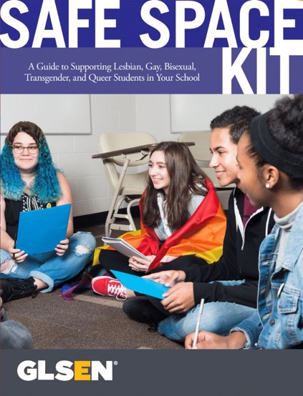


Classroom and Curricular Resources
Kit includes:
Guide, Safe Space Stickers, Safe Space Posters, Terminology, Promising Practices
To promote visible support for LGBTQ students

Slide 36
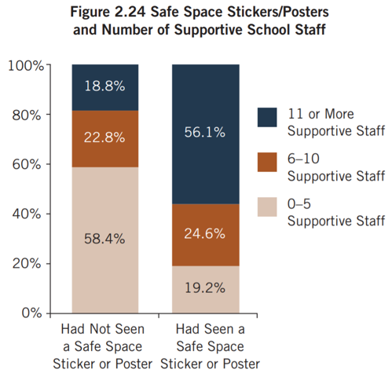
Classroom and Curricular Resources
Stickers & posters help students identify supportive school staff.

Slide 37

Classroom and Curricular Resources
READY, SET, RESPECT!
GLSEN’s Elementary School Toolkit
The lessons focus on name-calling, bullying and bias, LGBT-inclusive family diversity and gender roles and diversity and are designed to be used as either standalone lessons or as part of a school-wide anti-bias or bullying prevention program.

Slide 38
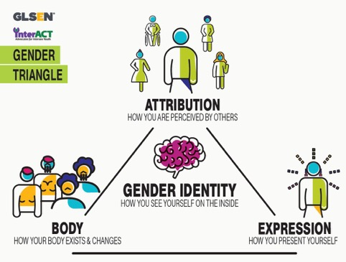

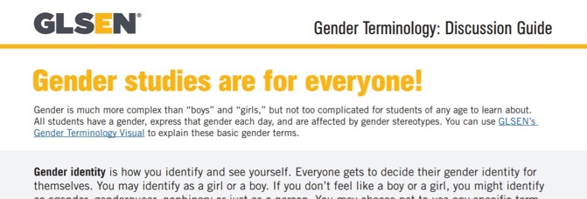

Resources on Gender Identity
Notes:
All of GLSEN’s resources for Supporting trans and gender expansive students can be found at www.glsen.org/trans

Slide 39
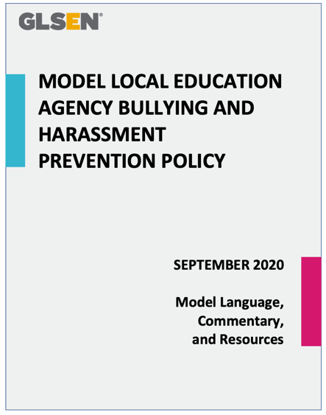

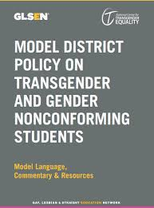
Policies
Inclusive policies regarding harassment and discrimination can provide guidance for students and educators on what behaviors is expected in school, how to report incidents and how to intervene.
Notes:
With regard to policie, schools and school administrators must:
Ensure that school policies and practices, such as those related to dress codes and school dances, do not discriminate against LGBTQ+ students;
Enact and implement policies and practices to ensure transgender and nonbinary students have equal access to education, such as having access to gendered facilities that correspond to their gender; and
Adopt and implement comprehensive school and district anti-bullying/harassment policies that specifically enumerate sexual orientation, gender identity, and gender expression as protected categories alongside others such as race, religion, and disability, with clear and effective systems for reporting and addressing incidents that students experience.

Slide 40
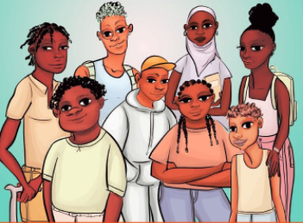
Create Safe Spaces for LGBTQ+ Youth
Research indicates that GSAs (Gender and Sexuality Alliances) improve school climate, individual well-being and educational outcomes for LGBTQ+ youth.
Groups can be school-based or community-based, and can focus on peer support and/or advocacy.
Notes:
And lastly, although extracurricular clubs in general are more common in schools in the U.S. and Canada, and many students report having GSAs – or Gender-Sexuality Alliances or Gay-Straight Alliances in their schools. LGBTQ+ students need safe spaces to talk to their LGBTQ+ peers. And schools can play an important role in facilitating that this happens even in countries where extracurricular clubs are not common.

Slide 41
Conclusion
With more school supports for LGBTQ+ students, we can work toward ending this global public health crisis.
Una scuola libera…
…da violenze di genere
…dall'omofobia e transfobia
…da stereotipi di genere
…dalla disinformazione
Una scuola libera per tutti

Slide 42

Questions?
Notes:
Emily

Slide 43
Contact:
Joseph Kosciw, Ph.D.
joseph.kosciw@glsen.org

